Slide 1
For Live Session
Unit 5

Slide 2
Part 1 (2 hours)

Slide 3
BBALL STUDY
We previously used a dataset called PlayerBBall.csv which contained information about NBA basketball players. To finish that assignment, you had to manipulate the height column. Review the code you used to do that and see if you can’t make more efficient code using regular expressions and / or the string functions from this Unit.
Use regular expressions to use the height column to create a TotalInches column that has the total height in inches and is recorded as a numeric variable.
Use this variable to make a chart that contains histograms of heights for every position (color coded).

Slide 4
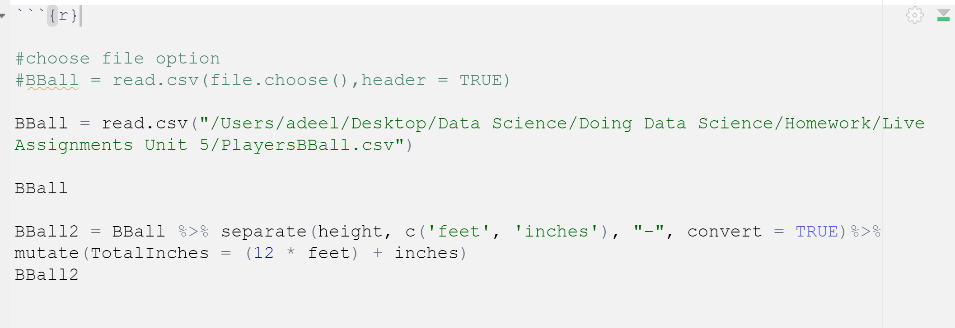

Slide 5
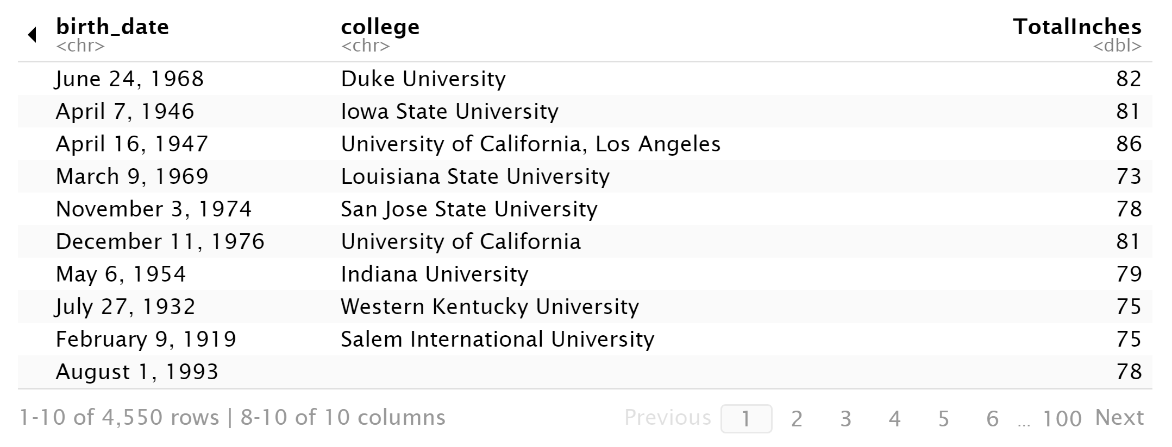

Slide 6
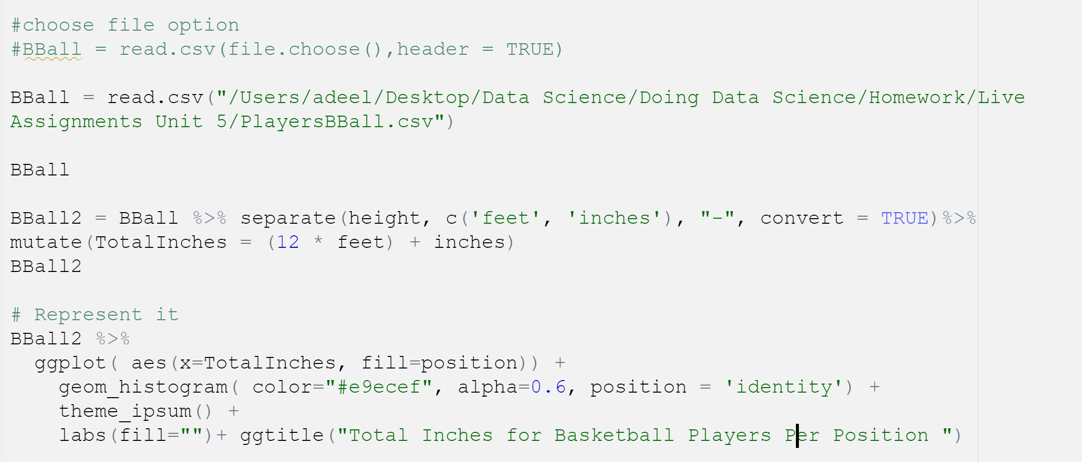
Code for Histogram

Slide 7
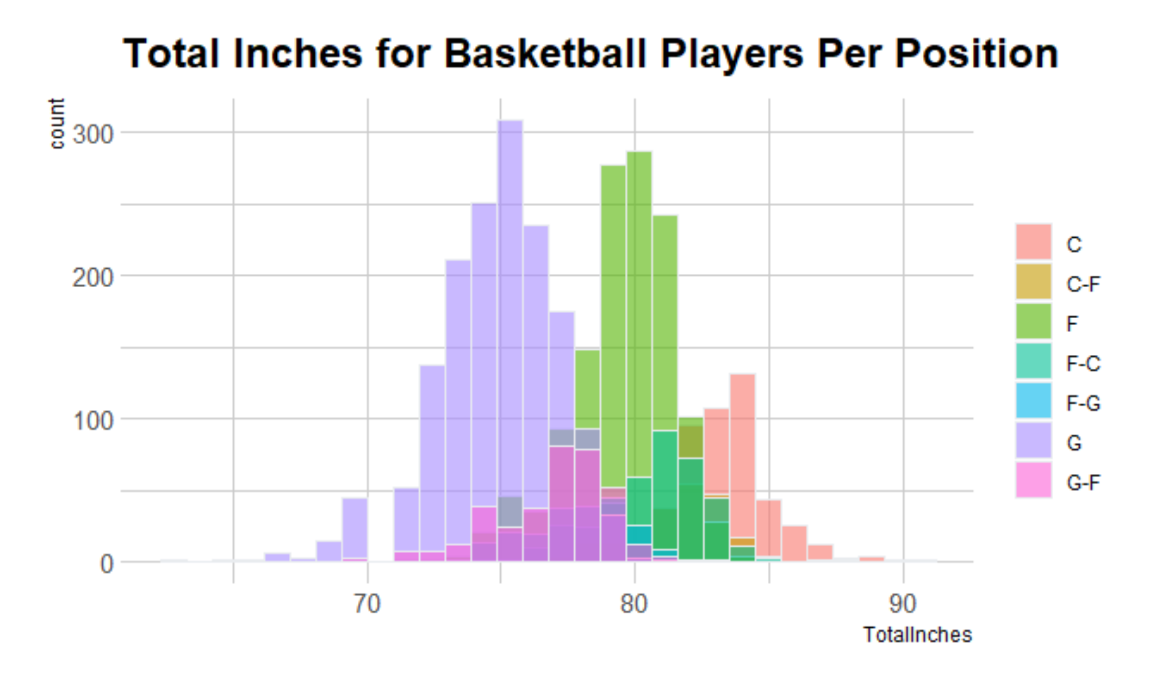
Histograms

Slide 8
Part 2 (2-3 hours)

Slide 9
FIFA STUDY
We previously used a dataset called FIFA Players.csv which contained information about Soccer players.
Use the string functions and regular expressions to assess a relationship between height and weight among soccer players. To do this you will need to manipulate the height and weight columns into columns that have numeric values of the height and weight. Tell your story using 2 – 4 PPT Slides.
Next, assess this relationship between just the LB and LM positions. (1 slide should do it.)

Slide 10
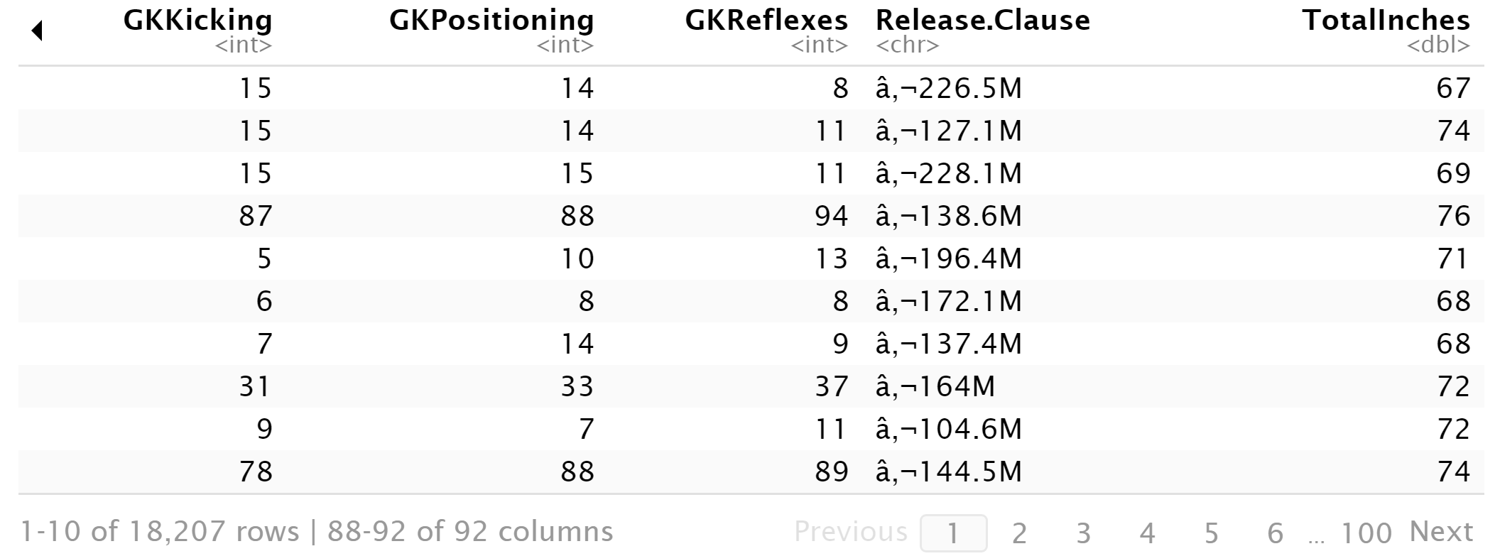
Total inches for Height

Slide 11
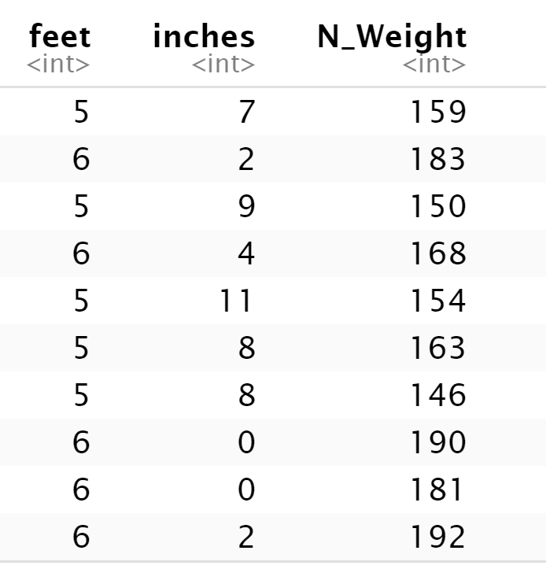
Weight

Slide 12
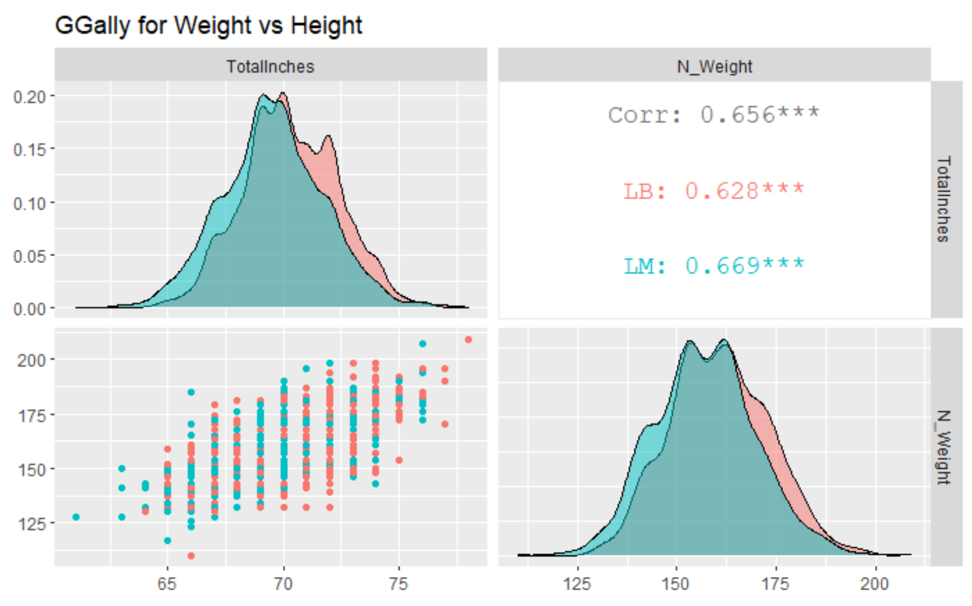

Slide 13
Part 3 (2 – 4 hours)

Slide 14
BABY NAMES
Backstory: Your client is expecting a baby soon. However, he is not sure what to name the child. Being out of the loop, he hires you to help him figure out popular names. He provides for you raw data in order to help you make a decision.

Slide 15
Baby Names: Question 1
Data Munging (30 points): Utilize yob2016.txt for this question. This file is a series of popular children’s names born in the year 2016 in the United States. It consists of three columns with a first name, a gender, and the amount of children given that name. However, the data is raw and will need cleaning to make it tidy and usable.
First, import the .txt file into R so you can process it. Keep in mind this is not a CSV file. You might have to open the file to see what you’re dealing with. Assign the resulting data frame to an object, df, that consists of three columns with human-readable column names for each.
Display the summary and structure of df
Your client tells you that there is a problem with the raw file. One name was entered twice and misspelled. The client cannot remember which name it is; there are thousands he saw! But he did mention he accidentally put three y’s at the end of the name. Write an R command to figure out which name it is and display it.
Upon finding the misspelled name, please remove this particular observation, as the client says it’s redundant. Save the remaining dataset as an object: y2016

Slide 16
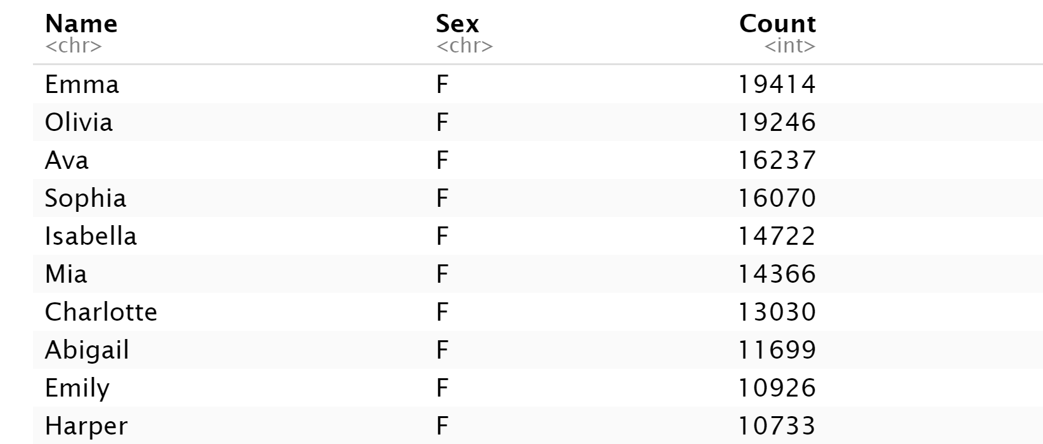
a.

Slide 17
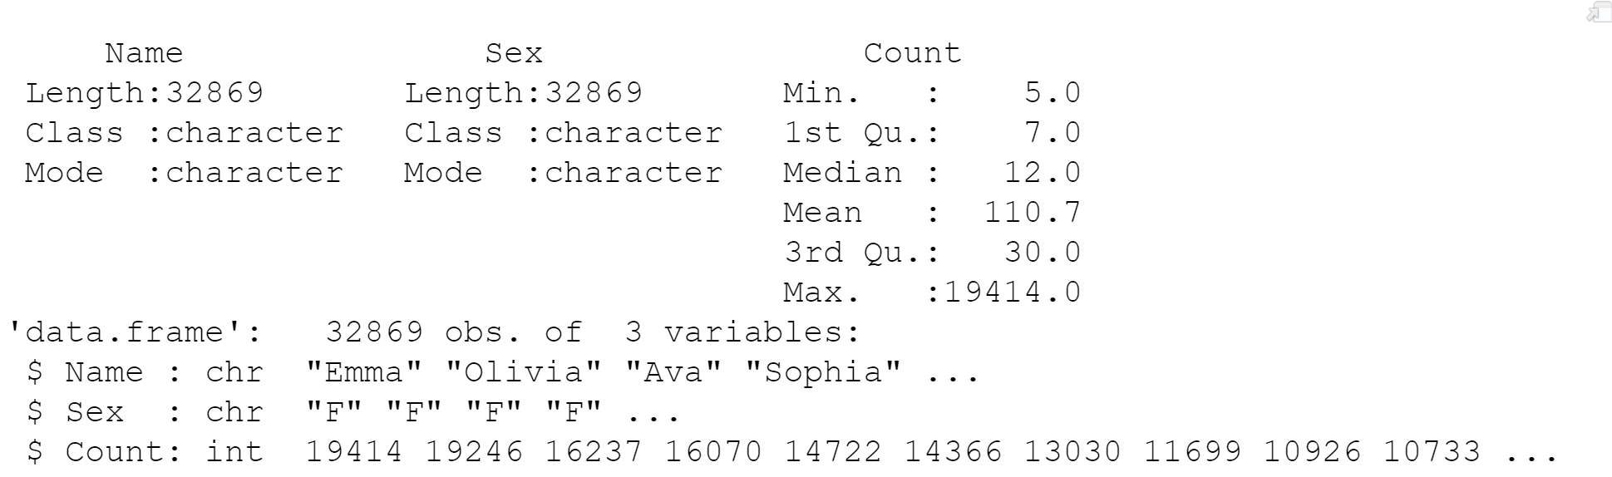
b

Slide 18
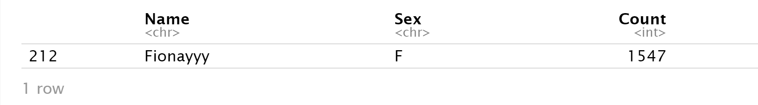
c

Slide 19
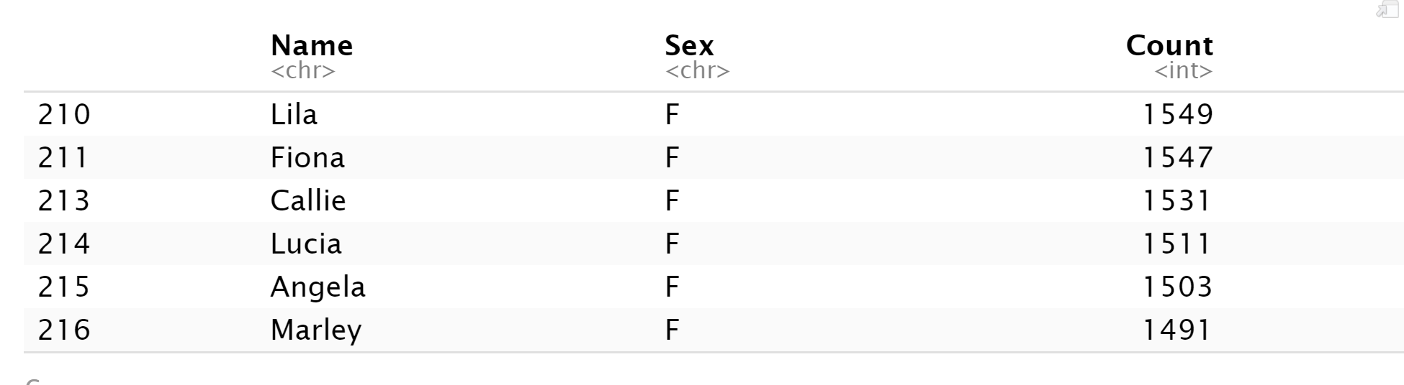
d

Slide 20
Baby Names: Question 2
2. Data Merging (30 points): Utilize yob2015.txt for this question. This file is similar to yob2016, but contains names, gender, and total children given that name for the year 2015.
Like 1a, please import the .txt file into R. Look at the file before you do. You might have to change some options to import it properly. Again, please give the dataframe human-readable column names. Assign the dataframe to y2015.
Display the last ten rows in the dataframe. Describe something you find interesting about these 10 rows.
Merge y2016 and y2015 by your Name column; assign it to final. The client only cares about names that have data for both 2016 and 2015; there should be no NA values in either of your amount of children rows after merging.

Slide 21
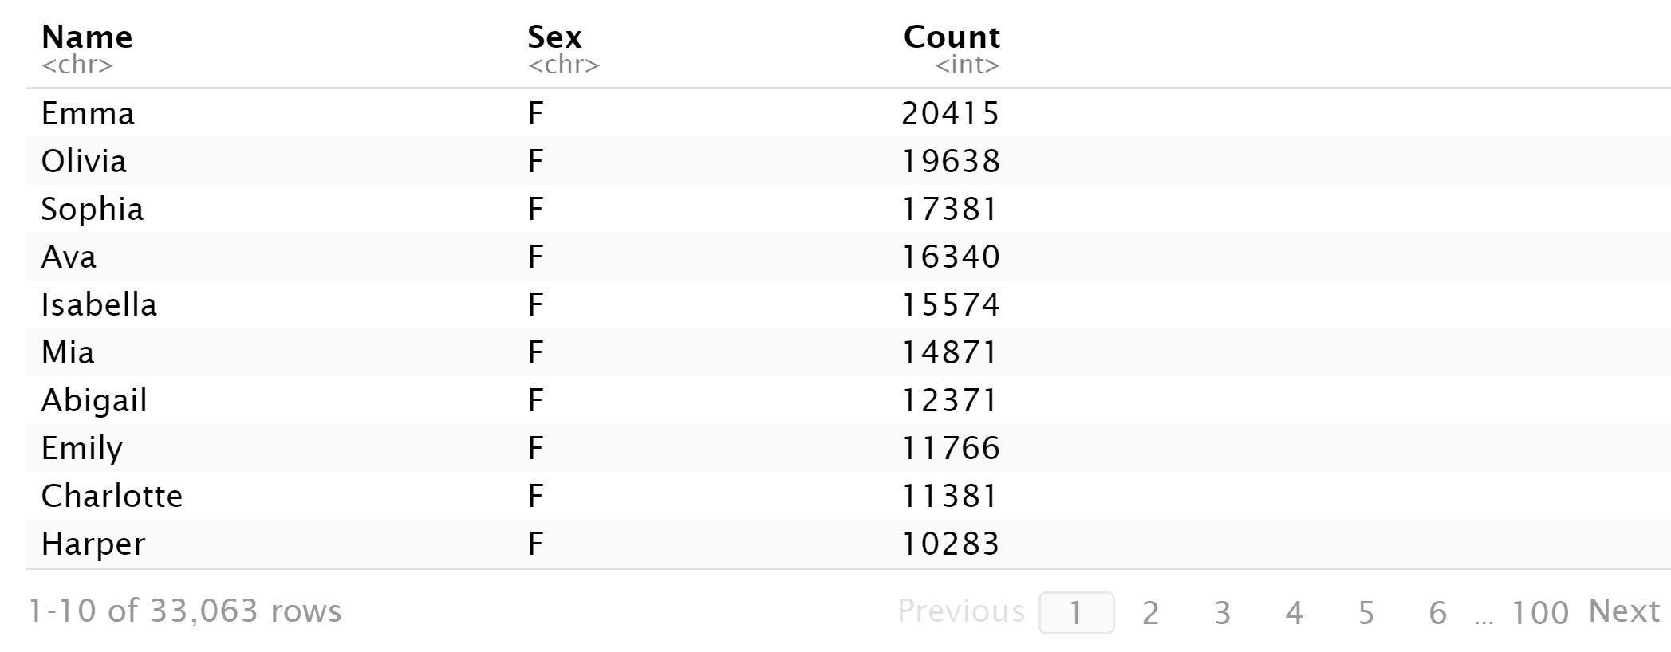
a

Slide 22
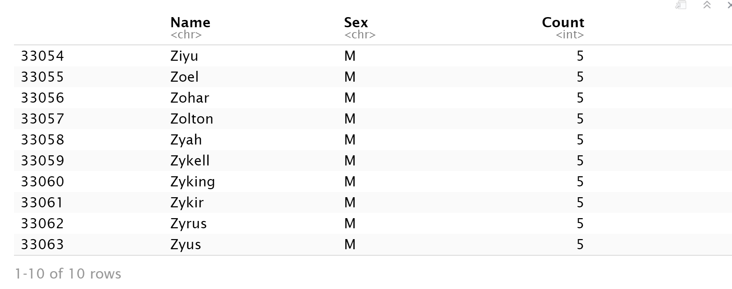
b

Slide 23
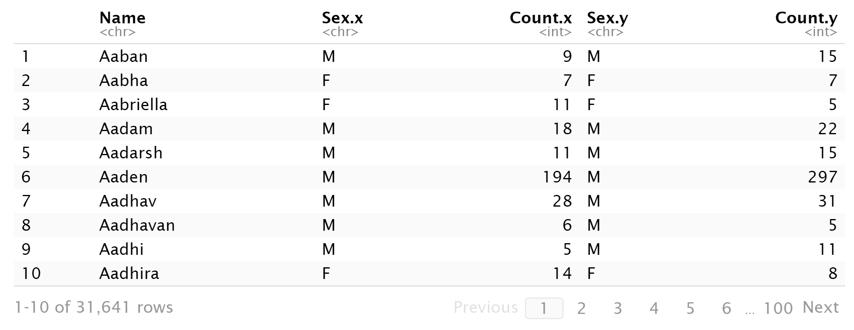
c

Slide 24
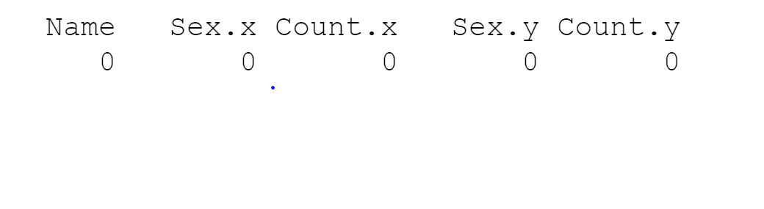
c

Slide 25
Baby Names: Question 3
3. Data Summary (30 points): Utilize your data frame object final for this part.
Create a new column called “Total” in final that adds the amount of children in 2015 and 2016 together. In those two years combined, how many people were given popular names?
Sort the data by Total. What are the top 10 most popular names?
The client is expecting a girl! Omit boys and give the top 10 most popular girl’s names.
Write these top 10 girl names and their Totals to a CSV file. Leave out the other columns entirely.

Slide 26
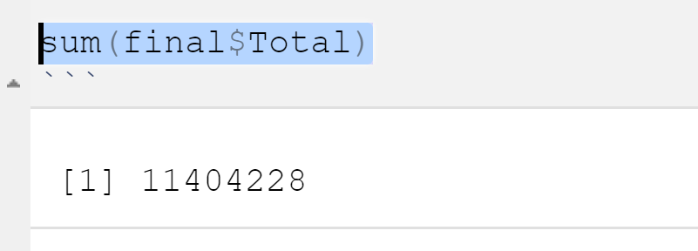
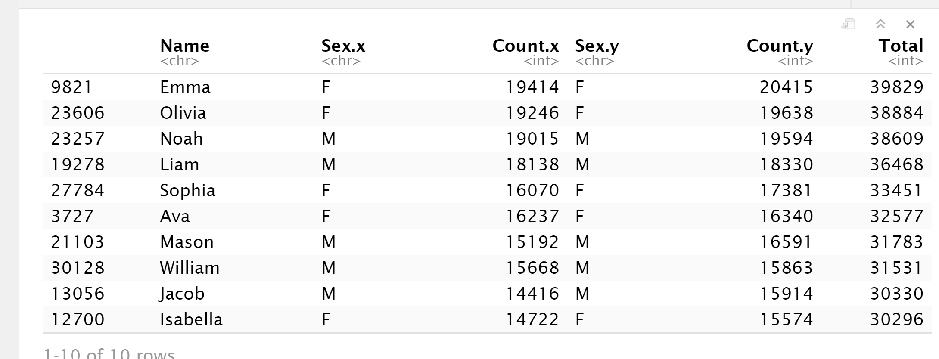
A & B

Slide 27
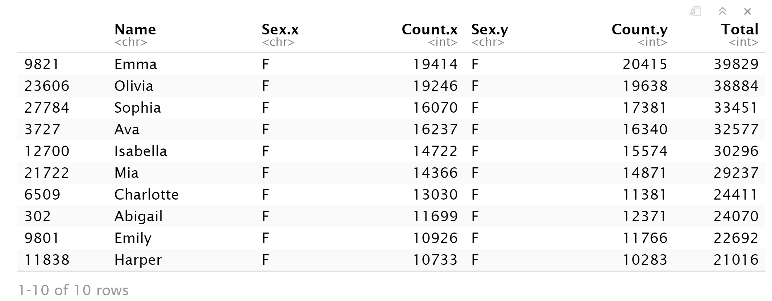
c

Slide 28
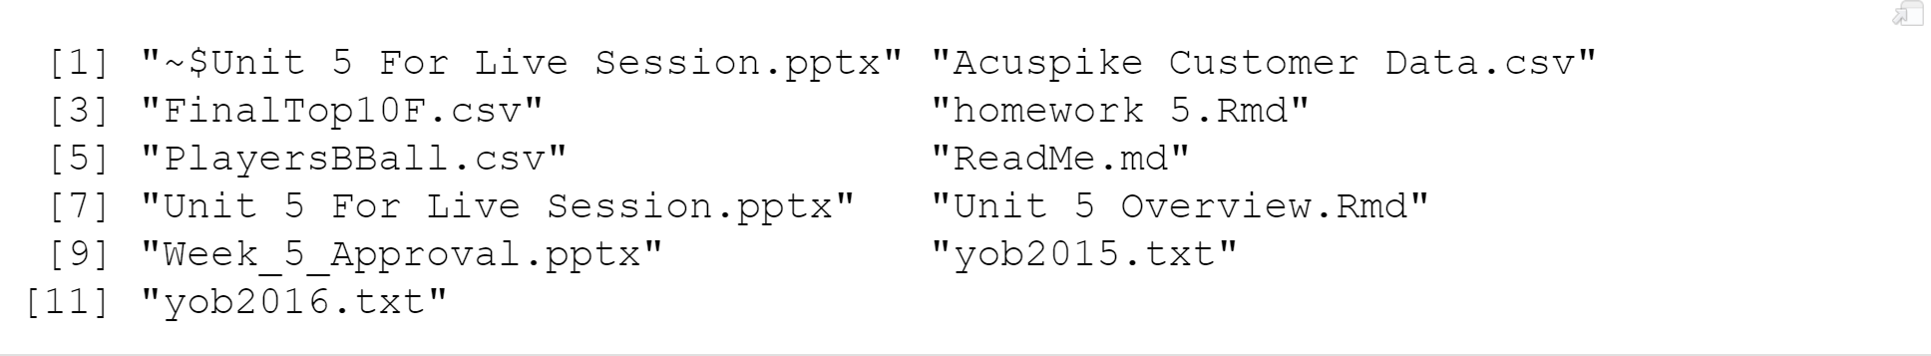
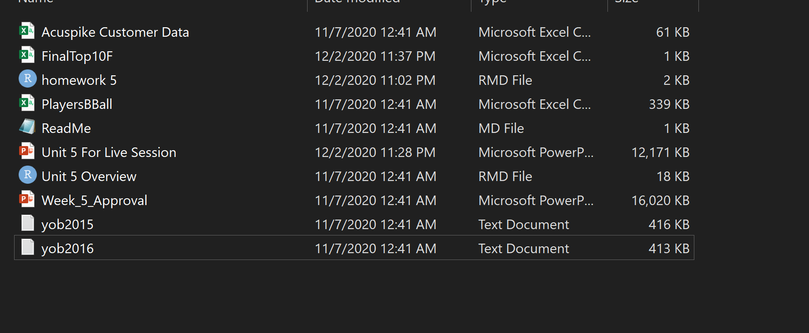
d

Slide 29
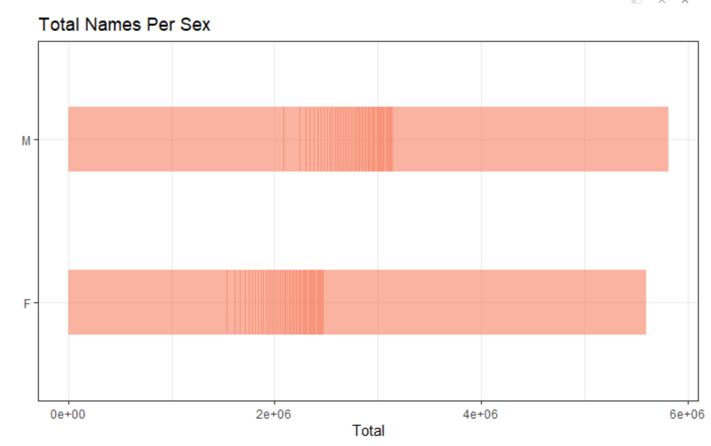
Baby Names: Question 4
4. Data Visualization: Create a well labeled, visually appealing and informative visualization summarizing some of the results of this study.

Slide 30
Summary
There were more names for males that were selected in total when compared to females. This could mean that during 2015 & 2016 there were more boys born. But since this is observational study we cannot make an inference to the generalized population beyond the data.

Slide 31

Part 4 ($≤1 hour$)
Takeaways
and
questions!

Slide 32
Takeaways
Interesting stuff by using string to clean the data and analyze.
I think this exercise improved my skills a little more and in wrangling the data.

Slide 34
NOT ASSIGNED … ALTERNATIVE QUESTIONS
But feel free to answer them for extra practice!

Slide 35
For Live Session
1. On 3-5 PowerPoint slides and using the nycflight13 datasets, complete Exercises 1 – 5 (pages 186-187) from the Wickham text.
2. Using the sentences dataset from stringr (that we used in this Unit) find all contractions and separate out the pieces before and after the apostrophe. Make a bar plot showing the frequency of the piece after the contraction.
3. Using the NYT (New York Times) dataset from the last example in the videos, create an additional visualization. Bonus: If you have time, improve the classifier if you have an idea of how to do so.
4. Use the Twitter API to download tweets and analyze the frequency of positive and negative words to judge sentiment. You will need the tidytext package and you can get a list of words that have been tagged as positive and negative using the function call get_sentiment(“bing”). https://www.tidytextmining.com/sentiment.html You may choose the population of tweets you want to assess. Examples would be: a) the last 24 hours b) from the time of Hurricane Katrina c) from two Norman, OK and Austin Texas after the Texas / OU game, etc.
helpful twitteR functions are: searchTwitter(), twListToDF(), availableTrendLocations()
https://www.rdocumentation.org/packages/twitteR/versions/1.1.9/topics/searchTwitter
b = searchTwitter('Cowboys', geocode='32.7767,-96.7970,10mi’) #Dallas Cowboys in with 10 miles of Dallas)
Dallas is geocode='32.7767,-96.7970,10mi You can find other geocodes with a simple Google look up.

